Slide 1
Off-Grid Battery Charger
Zano Sgroi

Slide 2
Project description
220W wind powered CC/CV charger for 12V and 24V, 8Ah LFP battery packs
Charging rates of 1C (8A) and 0.25C (2A) based on generator frequency
Initial prototype utilizes a gate driver evaluation board
TI F28379D LaunchPad used for feedback control and system I/O

Slide 3
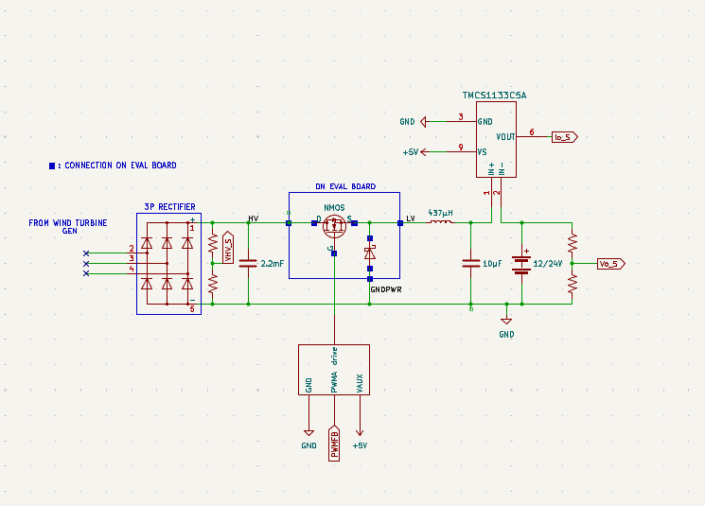
High level schematic

Slide 4
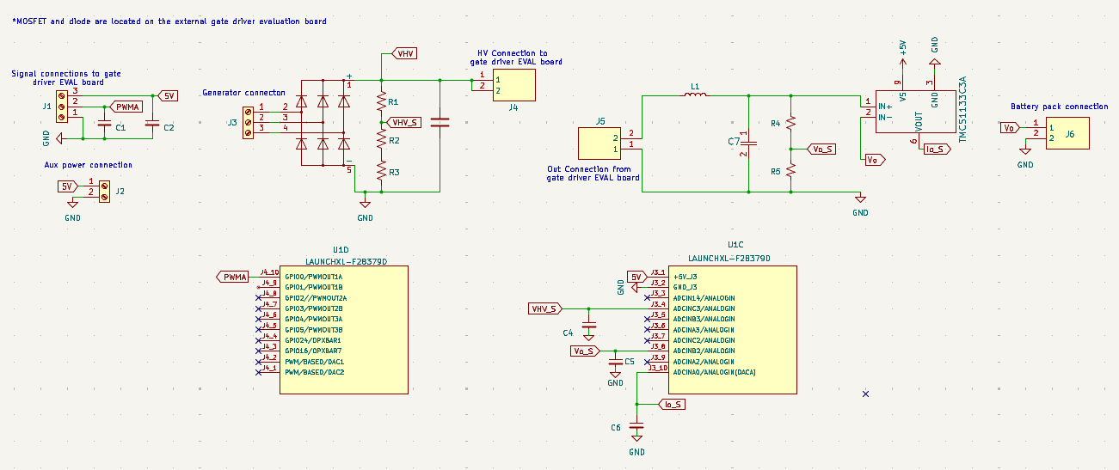
PCB schematic

Slide 5
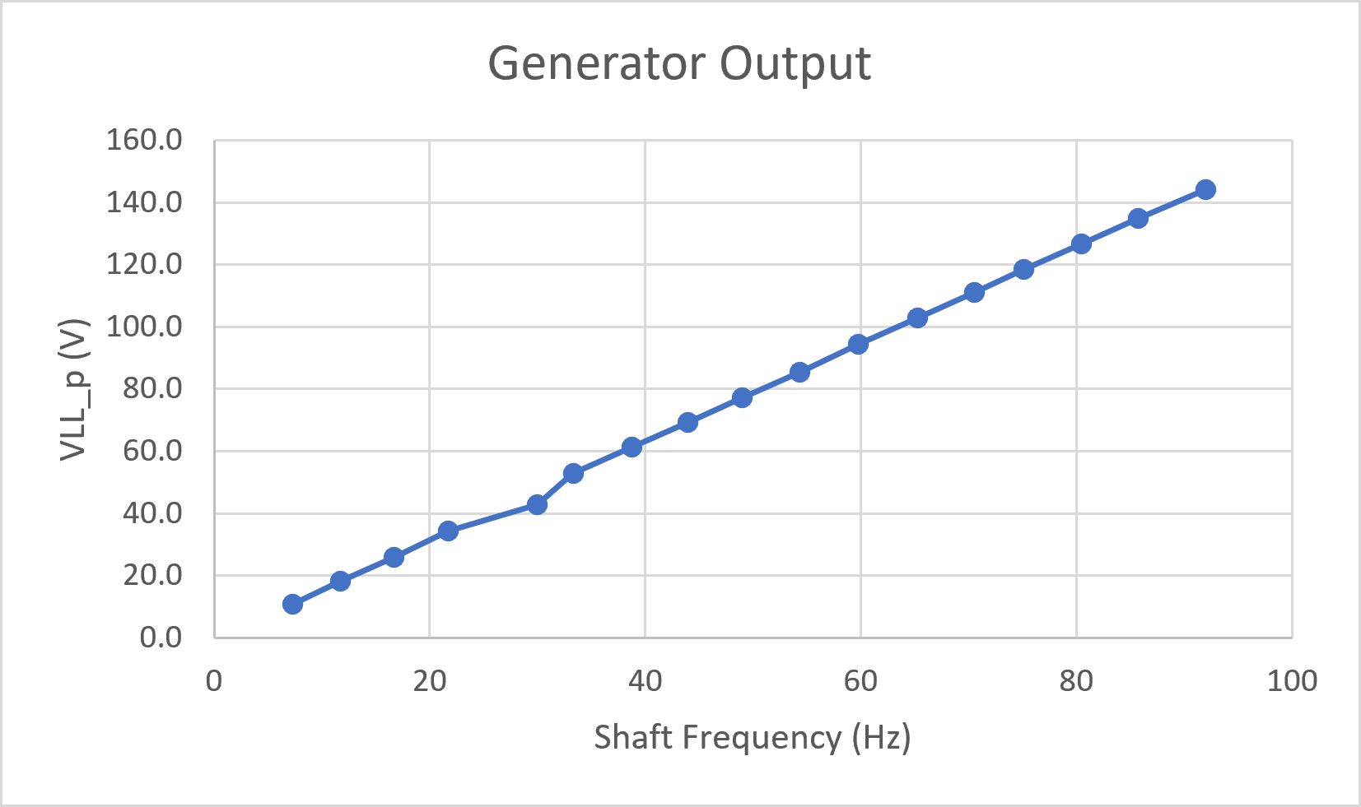
Generator output data

Slide 6
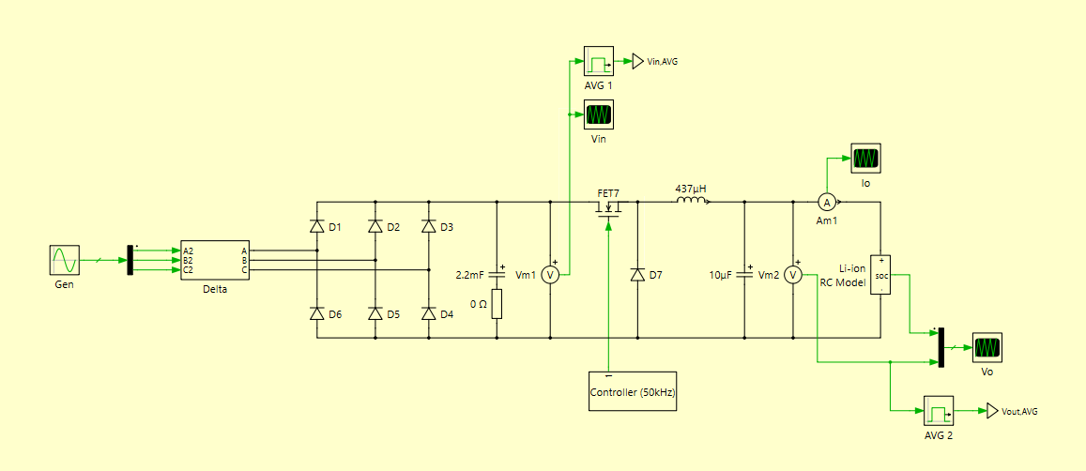
PLECS system simulation

Slide 7
Random operating point simulation
24V battery pack at 63% SOC
8A charging current
Generator L-L peak output of 112V at 71 Hz

Slide 8
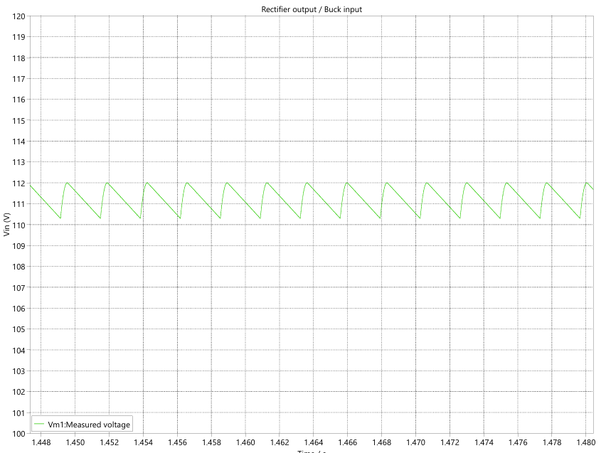
Rectifier output voltage (Vm1)

Slide 9
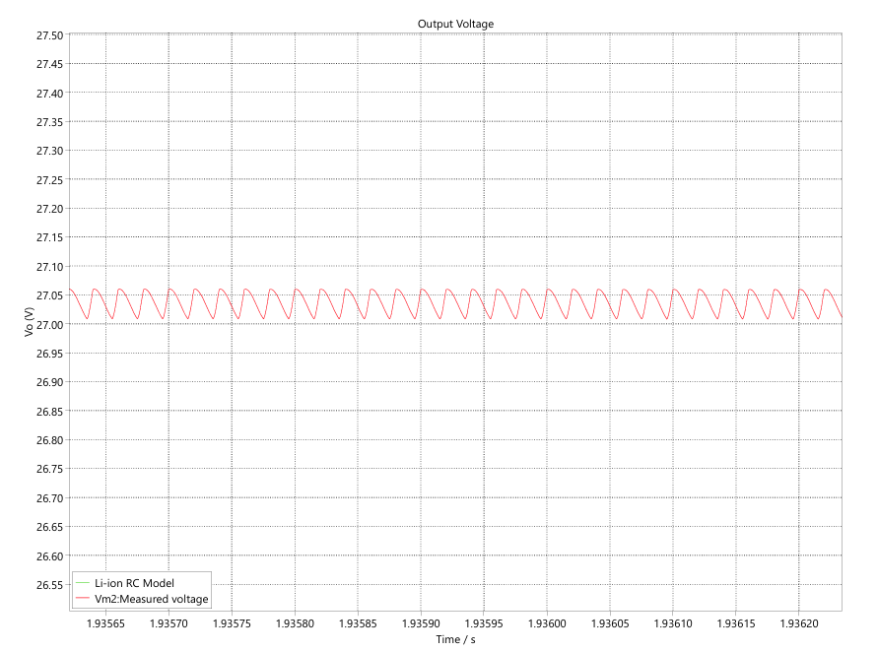
Battery Voltage (Vm2)

Slide 10
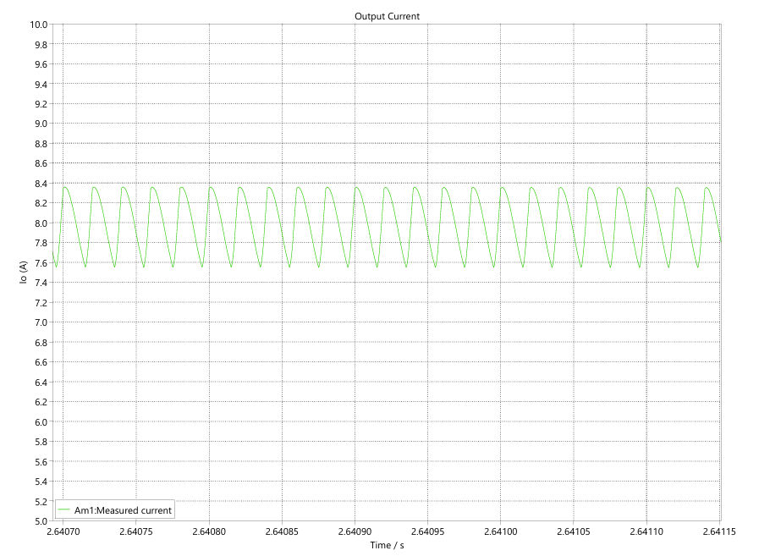
Battery Current (Am1)

Slide 11
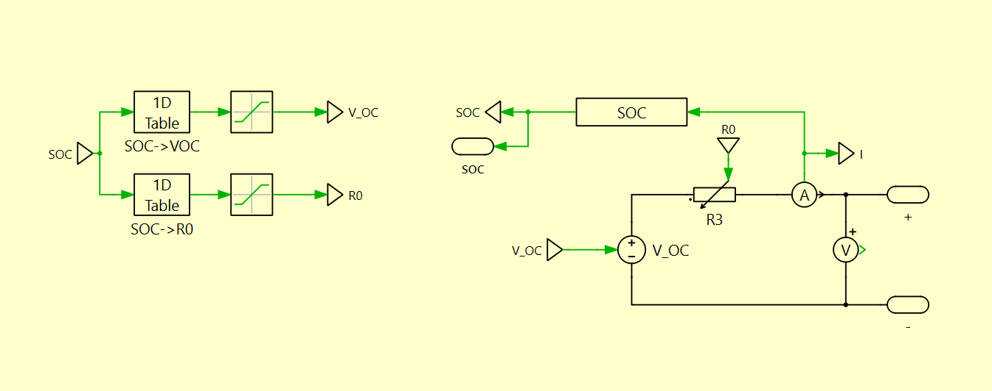
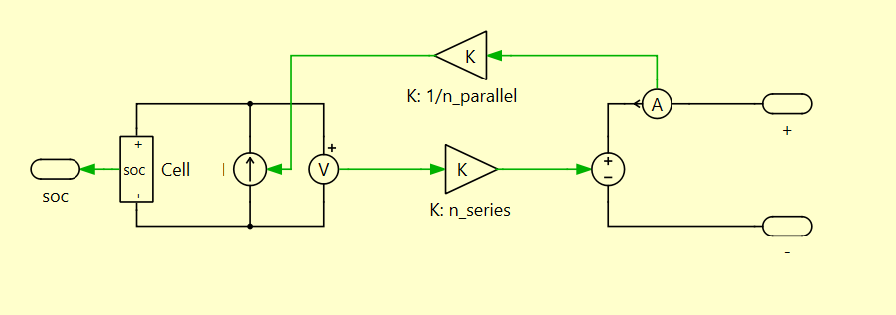
LFP battery model

Slide 12
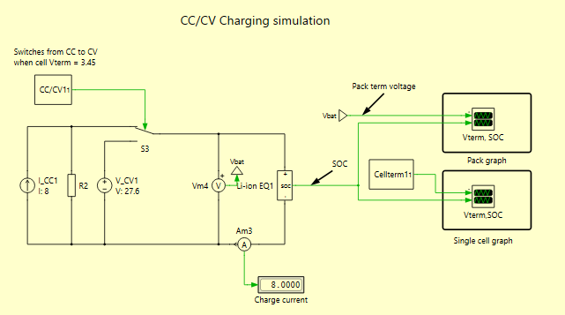
Battery pack model charging simulation

Slide 13
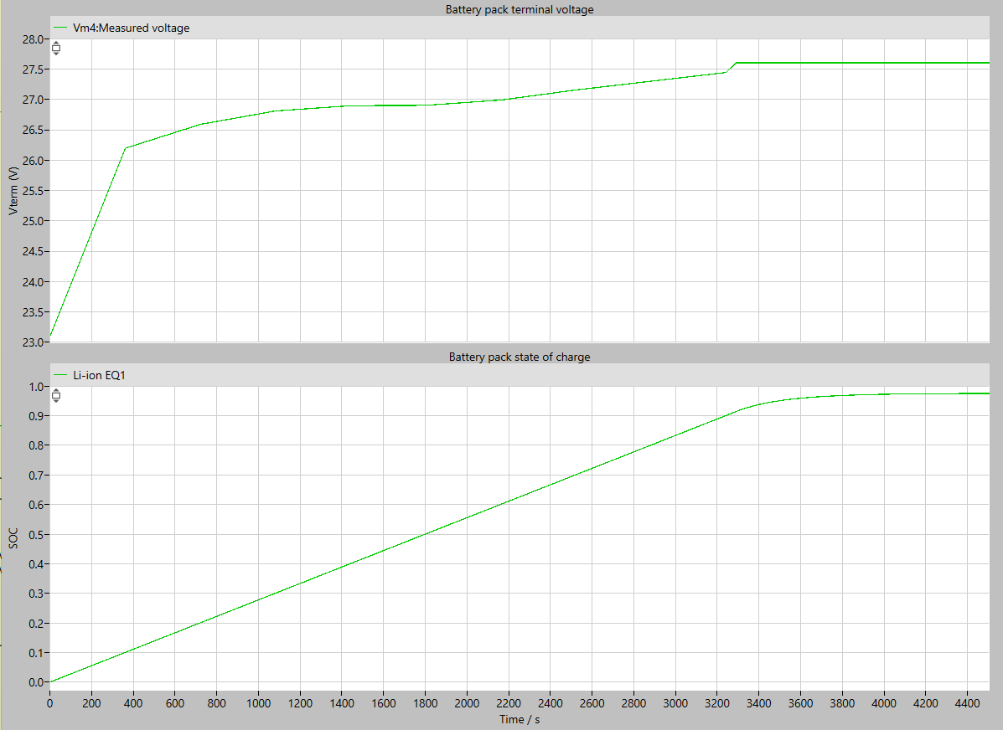
Battery pack model charging graph

Slide 14
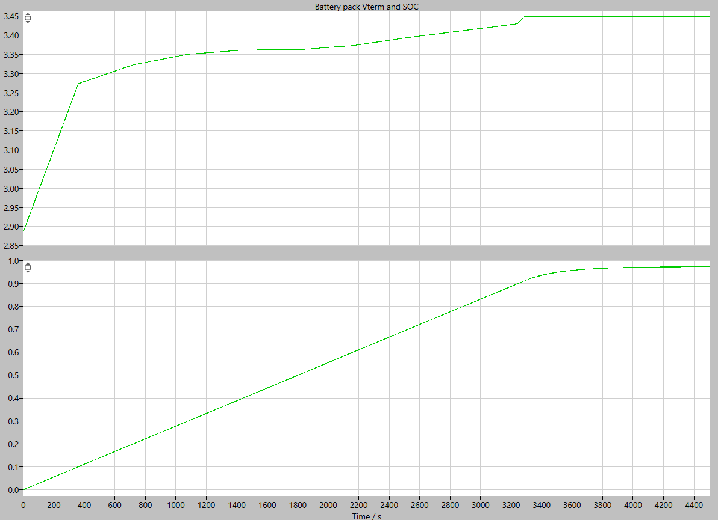
Battery cell model charging graph

Slide 15
Rectifier capacitor and gen freq. graphs
MATLAB graphs show the worst-case rectifier capacitance for each VLL to keep voltage ripple below 5%
Increasing charging currents are graphed: 1A, 2A, 4A, 8A and 12A
22mF point is shown on the 2A and 8A graphs
Capacitance requirement is the same at these points due to charging current difference

Slide 16
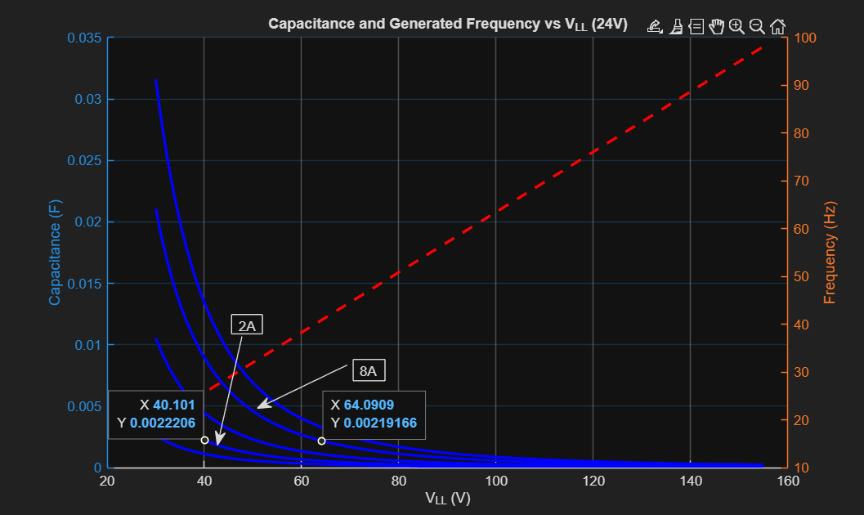
24V pack

Slide 17
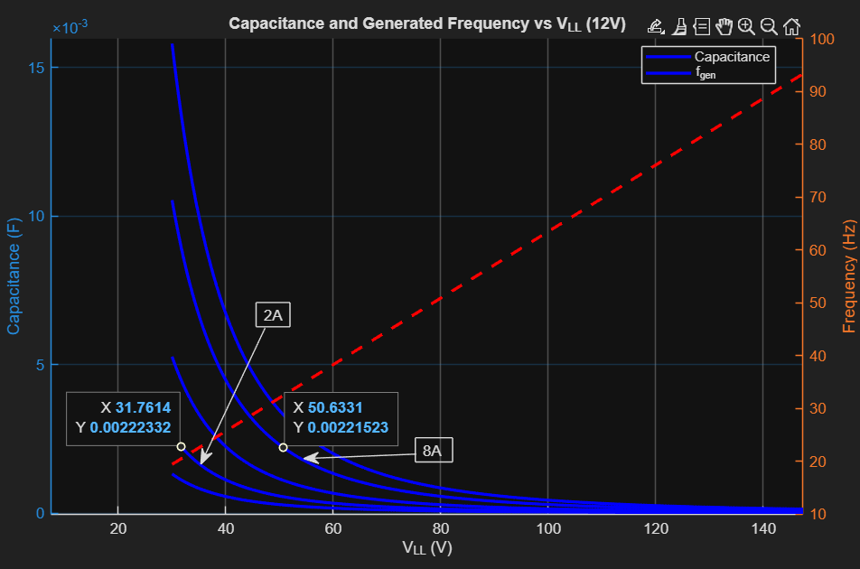
12V pack

Slide 18
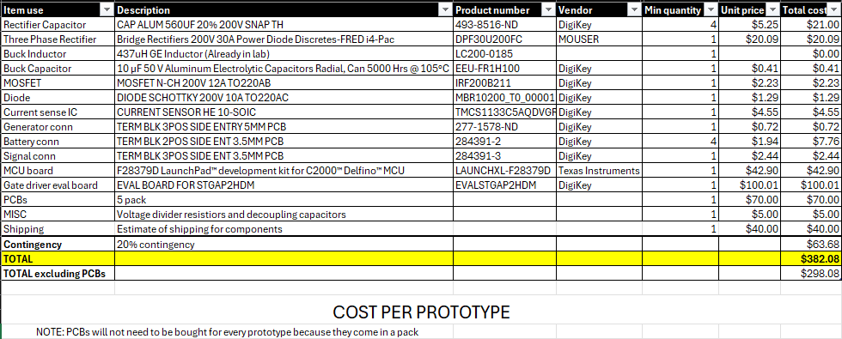
Bill of materials

